Slide 1



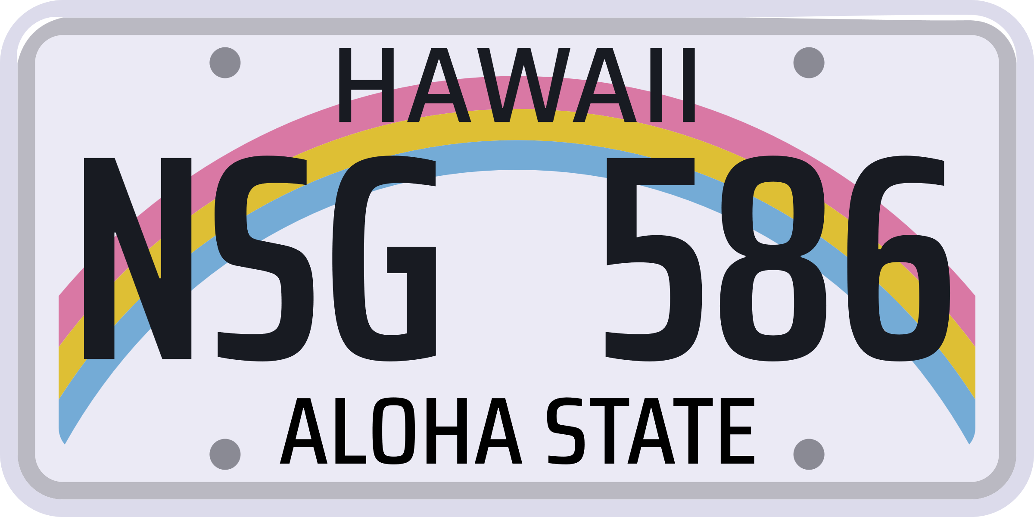


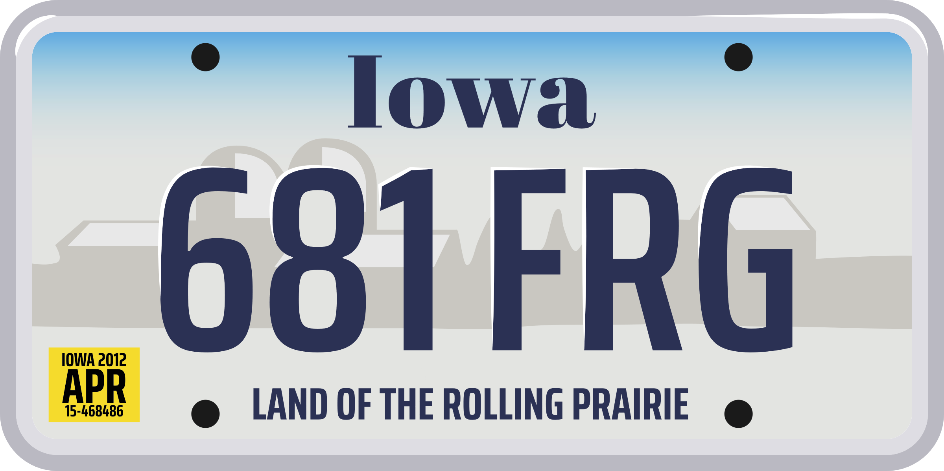


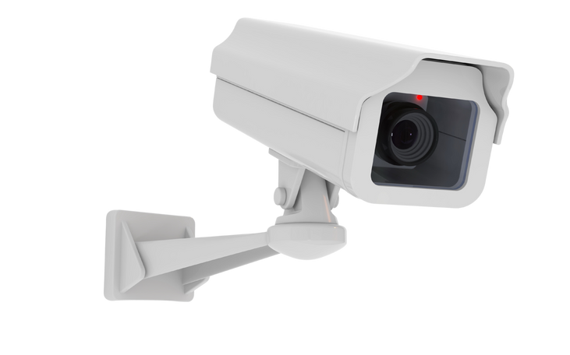

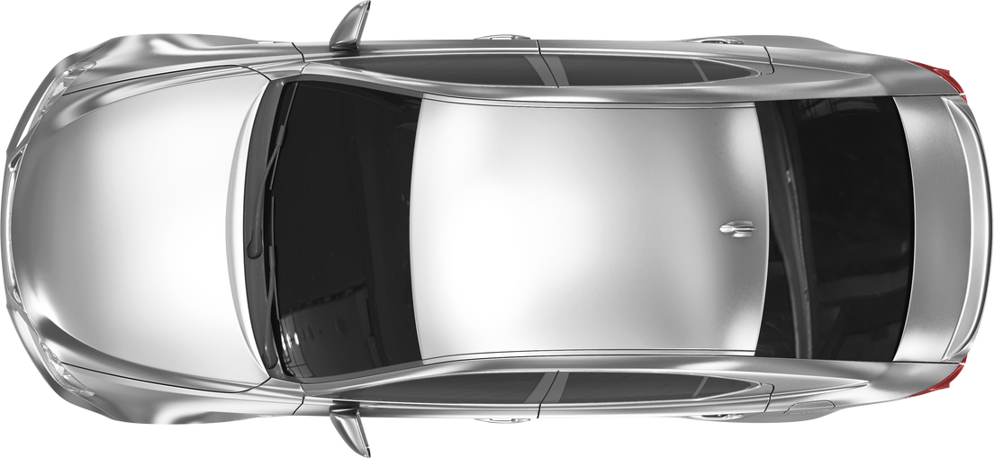
PARKIFY
A SMART PARKING SOLUTION
TAN MIN HAN
G00377211
BEng (Hons) Software and Electronic Engineering

Slide 2
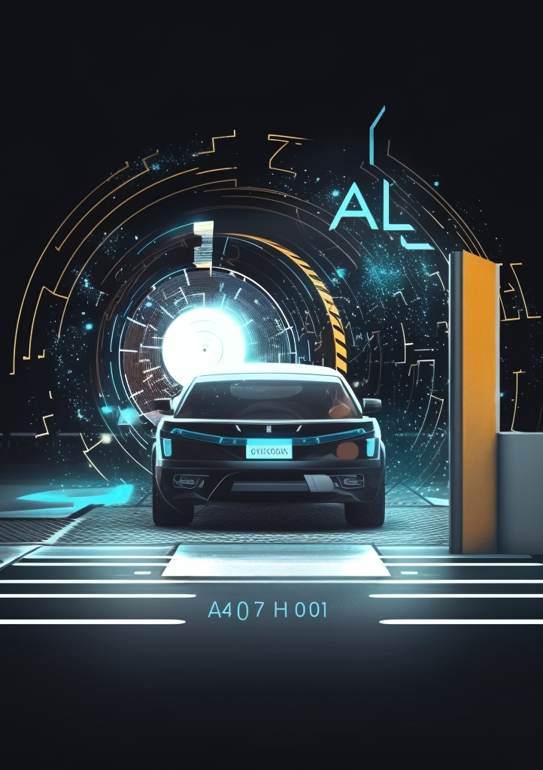
Agenda
Introduction to Parkify
02
Architecture Diagram
03
Project Timeline
04
Technologies behind Parkify
05
Challenges
06
Results
07
Conclusions
07
01

Slide 3



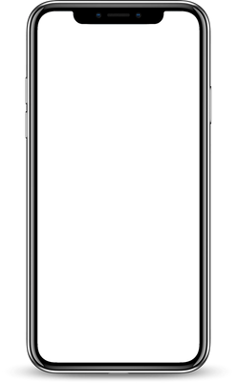


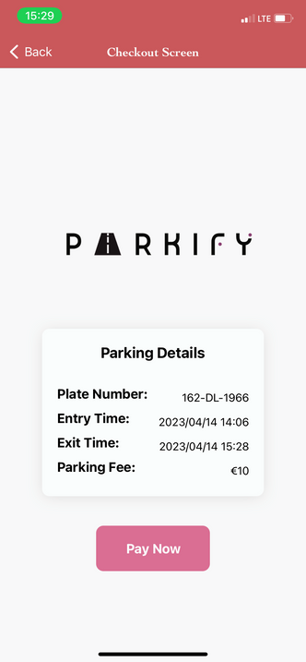


Introduction
Goal
The goal of Parkify is to provide real-time information about parking availability and automate the process of parking.
What is Parkify?
A system for the parking lots integrated with automated license plate recognition technology. and mobile application.
It uses a combination of object detection and OCR to detect and read license plates accurately
Provides real-time parking data
The system can be integrated with existing parking management systems to improve efficiency.
02

Slide 4
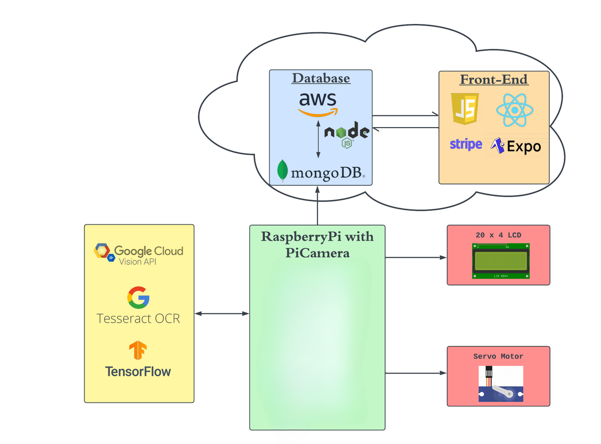




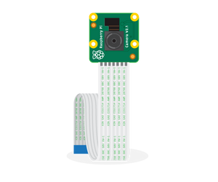
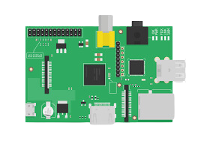






Architecture Diagram
Technologies Integration
MACHINE LEARNING
GOOGLE CLOUD VERTEX AI
GOOGLE CLOUD VISION
TESSERACT OCR
TENSORFLOW
FRONT END
REACT NATIVE
EXPO
JAVASCRIPT
BACK END
MONGODB ATLAS
NODEJS
STRIPE
03

Slide 5
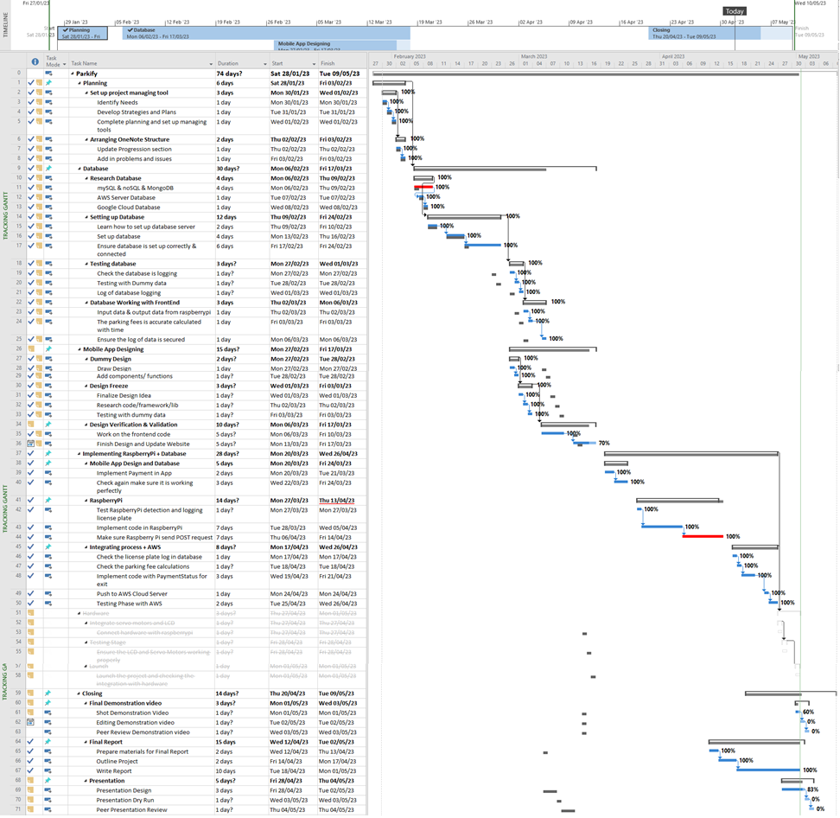
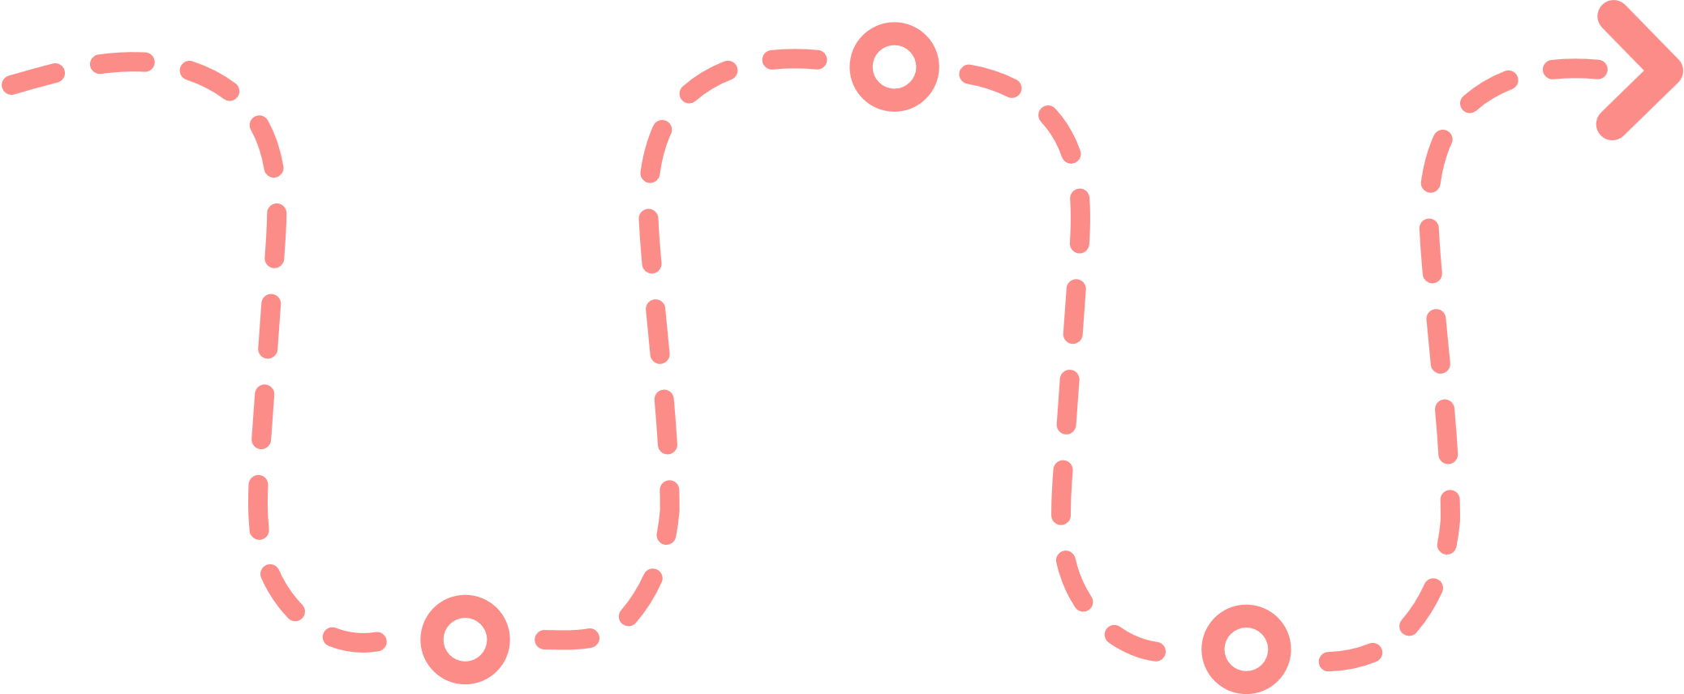
Project Timeline
Prioritize each work priority
Dependencies between tasks
Deadlines and the importance of meeting it
Handle challenges that caused delays.
04

Slide 6
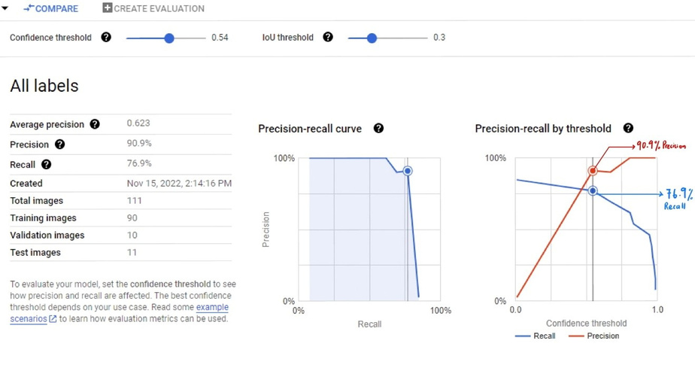
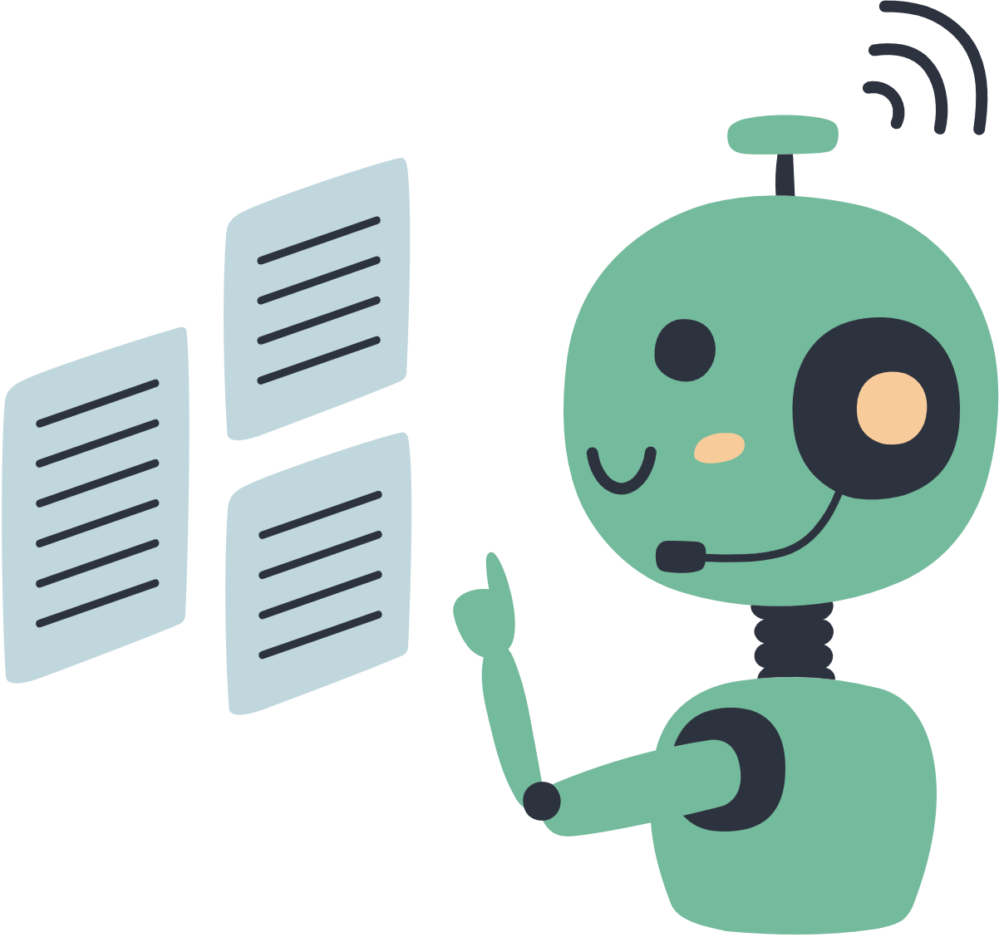

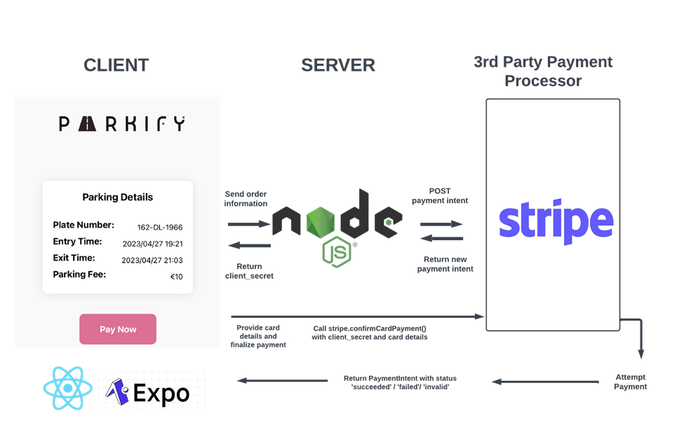


Challenges with Parkify
Training and Optimising
Model
Testing and debugging
Implementing ALPR and Raspberry Pi
Security features
05

Slide 7
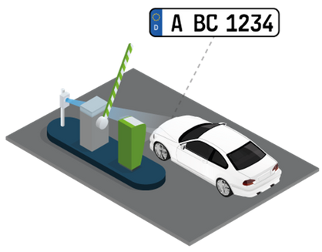
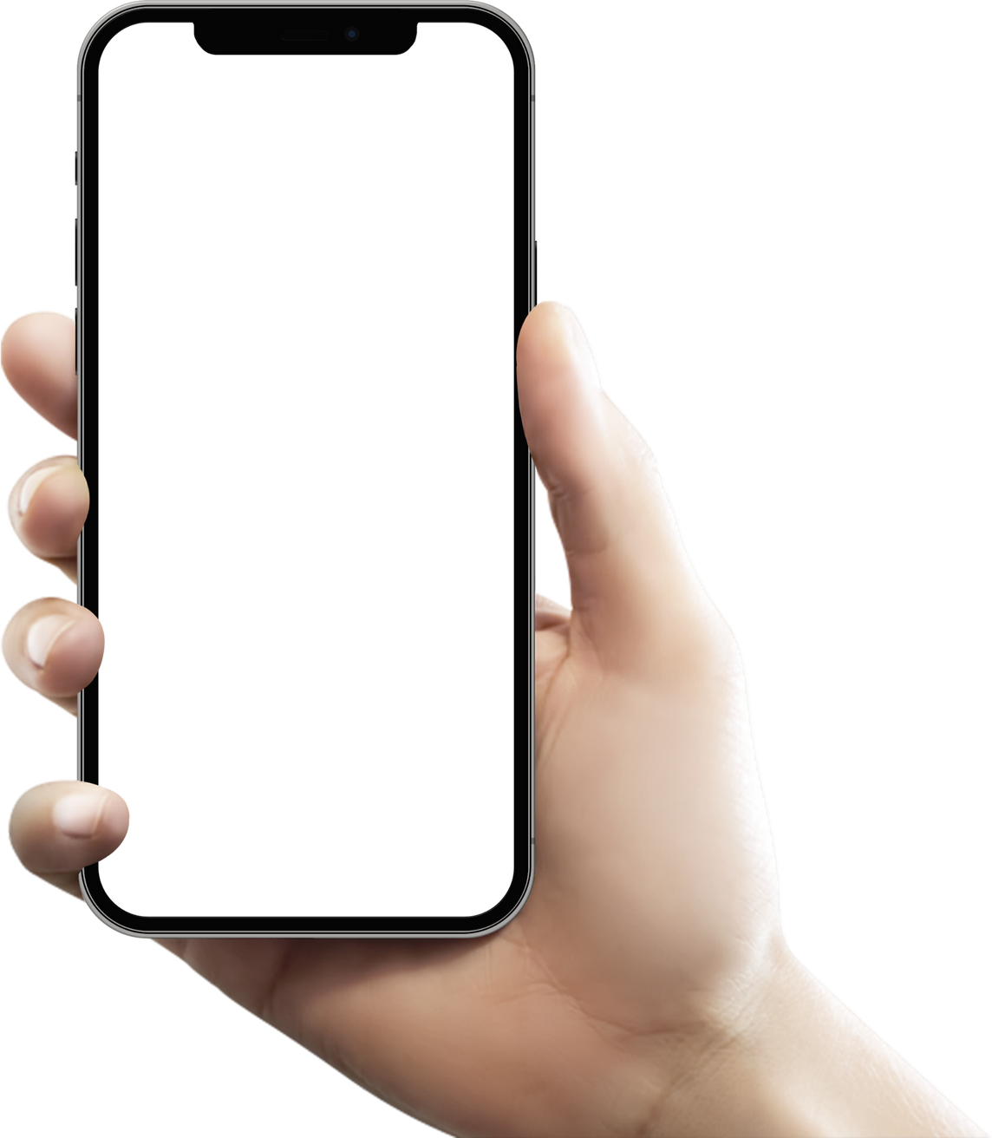
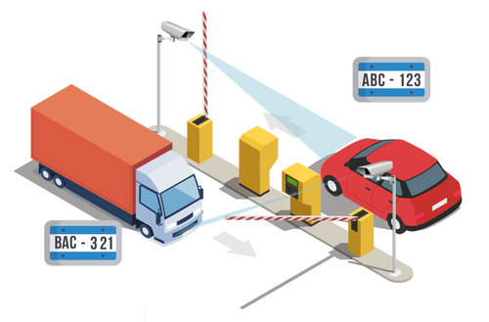
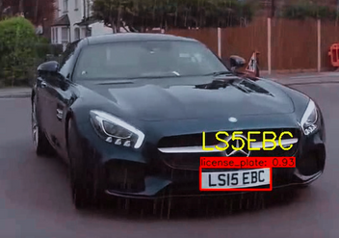
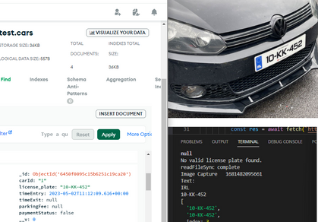

How Parkify works?
Raspberry Pi integrated with the TensorFlow model to detect the license plate using a trained model.
Google enhanced Tesseract OCR will extract the characters and numbers from the license plate
Save the license plate characters as text or image into database
Pay the parking fee with the mobile application
06

Slide 8
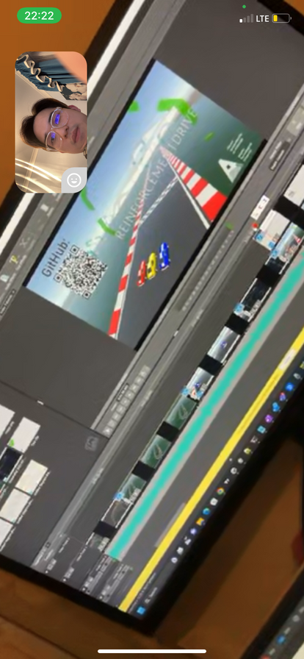
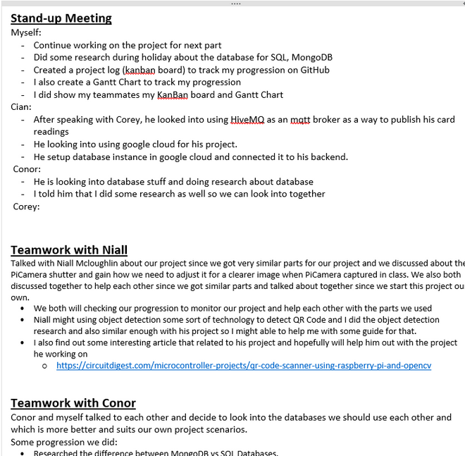

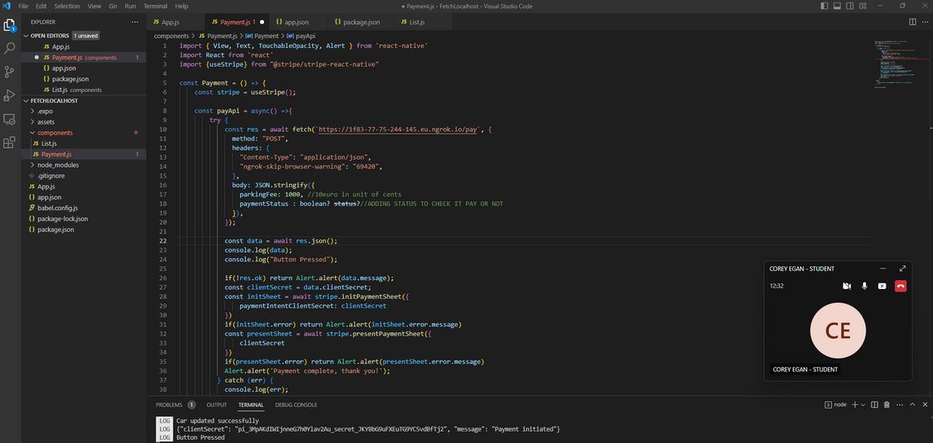
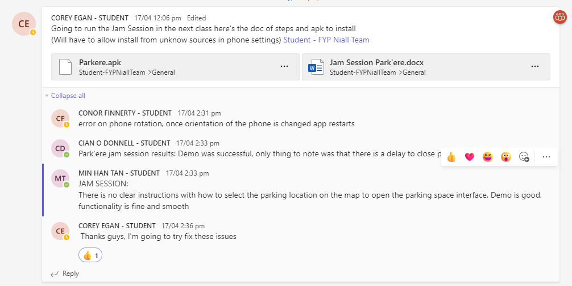
TEAMWORK
Stand-up meetings (Weekly Updates)
Teams Call
Report/Poster/Video Review
Jamming Session with Corey
07

Slide 9


Feel free to ask any questions!
07

